Slide 1


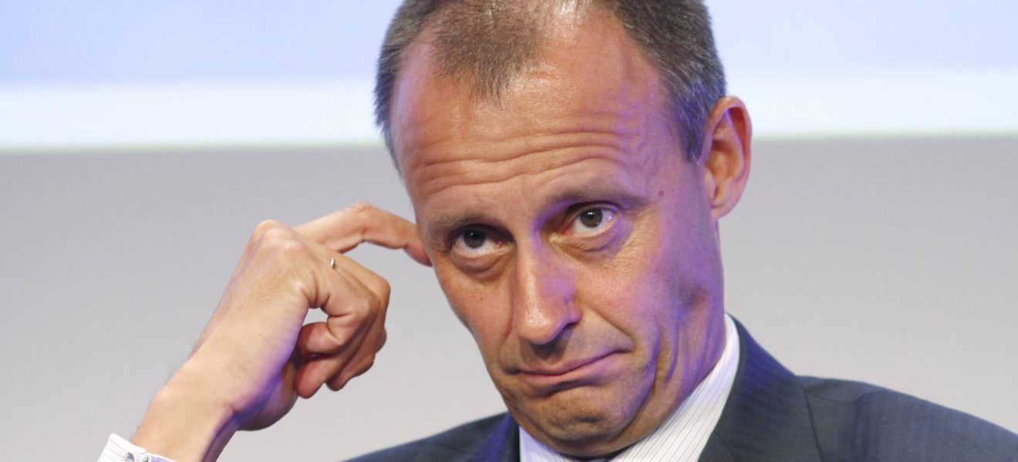









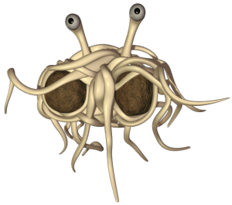
Corruption an lobbyism
Content
Introduction
Who are corrupt Politicians of the past 5 years?
Is there any good lobbyism?
What about the rest of the world?
What can we do against corruption?
How journalism helps against it
Conclusion
"Dieses Foto" von Unbekannter Autor ist lizenziert gemäß CC BY-SA-NC

Slide 2

World Corruption Index
The pandemic was like a big Test of how the politicians react to global crisis in relation of getting corrupt
emerging and developing countrys have the most corruption
In relation to the world, Germany doesnt have a problem with corruption
In Greenland there is no corruption (they just dont have data)

Slide 3
SOLUTION
Politicians should make their finances transparent and public

Slide 4
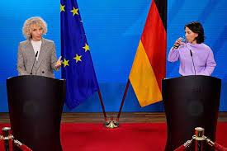
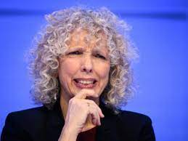
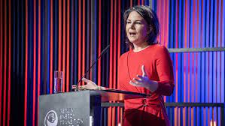
Is there a positive lobbyism?
-yes there is, for example:

Slide 5
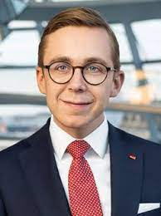

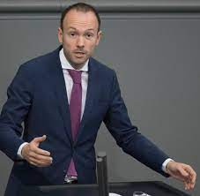
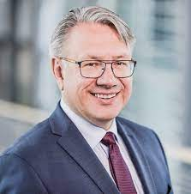
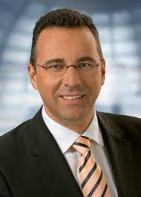
THE C-TEAM
Phillip Amthor
Niklas Löbel
Mask affair 2020
The oldest 29 years old alive
Georg Nüßlein
Joachim Pfeiffer
Mask affair 2020
Energy lobbyist

Slide 6
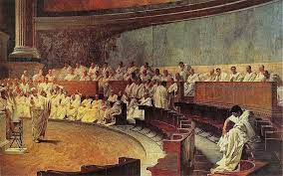






Slide 7
